Slide 1

SCI-PE New Coordinator Training: IU

Slide 2
Training Overview
Study Specimens
Kit Requests
Specimen Labels
Sample Collection
Sample and Processing Forms
Sample Shipping
Shipment Survey
NCRAD Website
FAQ
Contact Information

Slide 3
SCI-PE Study Specimens per Visit
Collection Tube | Drawn At | Specimen Type | Aliquot Volume | Total Number of Aliquots | Shipping Temperature
2 EDTA (Lavender-Top) Blood Collection Tubes (10 ml) | Week 1 & Month 24 | Plasma | 1.5 ml plasma aliquots | Up to 7 | Ambient
 | Week 1 & Month 24 | Buffy Coat | ~1.0 ml buffy coat aliquots | Up to 2 | Ambient

Slide 4
Kit Orders
Kits Available for Order
Link to Kit Requests
Completing the Kit Request Module

Slide 5
Kit Types Available for Order
SCI-PE Kit Request Survey: https://redcap.link/SCI-PE
IU:
  SCI-PE Week 1 Blood Kit
  SCI-PE Month 24 Blood Kit
  SCI-PE Supplemental Kit

Slide 6
When to Order Kits
Each site is responsible for ordering kits (labels are included) and maintaining a 1 month supply on site for scheduled participants
Please allow a minimum of 3 weeks for your order to be processed and delivered.
  Our kits are build to order and will be processed in the order received.
  Please email jazdicki@iu.edu regarding expedited orders.

Slide 7
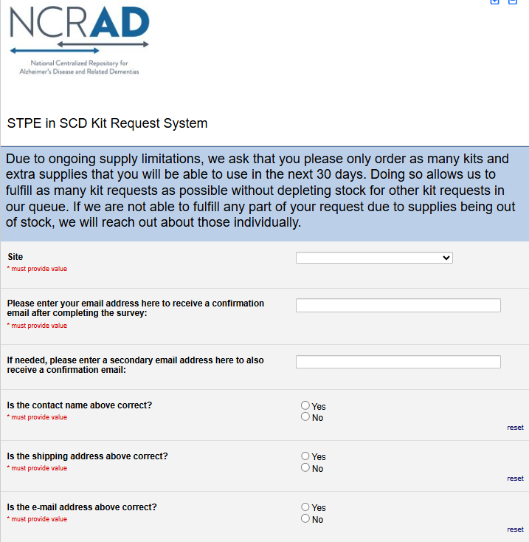
SCI-PE Kit Request Module
Choose your site from the drop-down list.
The coordinator name and contact information will appear.
  Verify that this information is accurate or correct it if necessary.

Slide 8
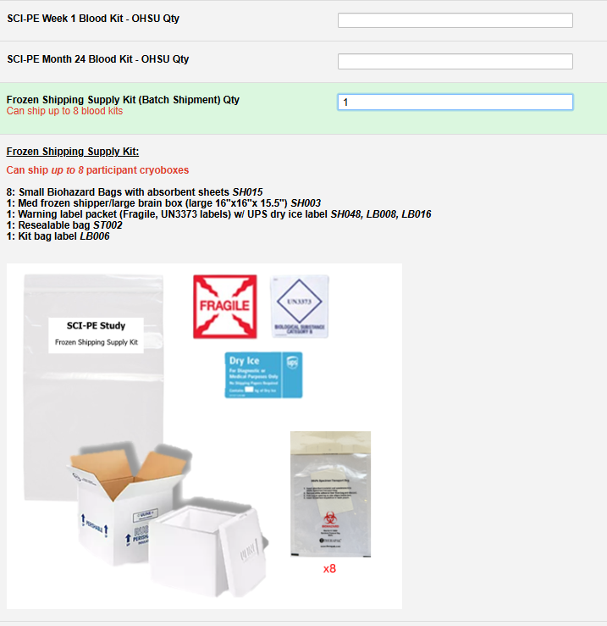
SCI-PE Kit Request Module (continued)
Indicate the quantity needed of each kit
Once selected, the kit components and pictures of the chosen kit will appear below for review
You can order more than one type of kit in a single kit request!
Important Note: Due to ongoing supply expiration issues, please limit your order to the kits/supplies you can use in the next 2 months

Slide 9
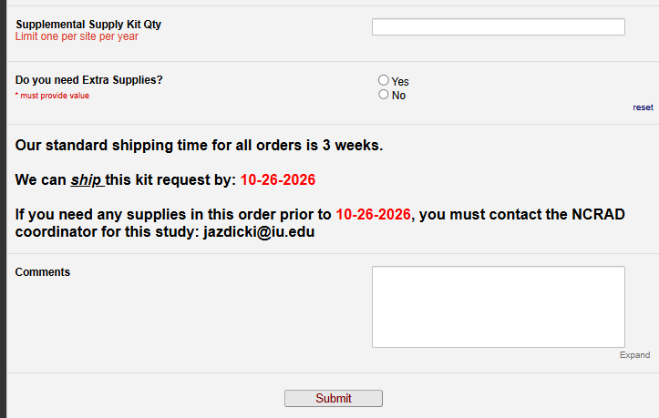
SCI-PE Kit Request Module (continued)
Each site may order 1 supplemental kit per year.
If you click Yes to “Do you need Extra Supplies” a list of supplies will populate.
  If you need a supply that is not listed, make a comment below or email NCRAD coordinator.
Important Note: The form will calculate your ship date 3 weeks from date of order. That is the date your order will be shipped by (not delivered).
If you need something sooner than this date, you must email NCRAD coordinator and specify what you need and the date needed.
Once the request is completed, click submit and you will receive an automated confirmation email of your request.

Slide 10
Specimen Labels
Types of labels provided
Labeling tubes for NCRAD lab

Slide 11
Three Label Types
Kit Number Labels​
SCI-PE ID Labels
Collection and Aliquot Tube Labels​
  Differ by specimen type

Slide 12
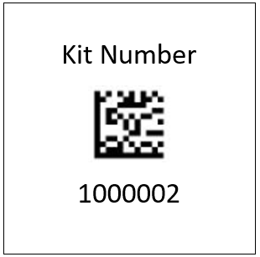
Kit Number Labels
Used to track participant samples and provide quality assurance, unique to the subject and visit
Need to be placed on the following locations:
  IU: Outside the kit bag when transporting to the STAT lab
  Biological Sample and Shipment Notification Form (as needed)

Slide 13
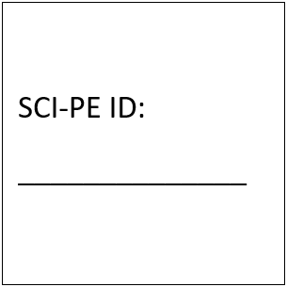
SCI-PE ID Label
Used to identify a participant by their unique patient ID and are used to help organize collection tube labels during collection and processing.
Sites will be responsible for handwriting this onto the provided labels
  Please use a fine point marker
  Write information on label prior to adhering to tube
  Place on all collection tubes

Slide 14
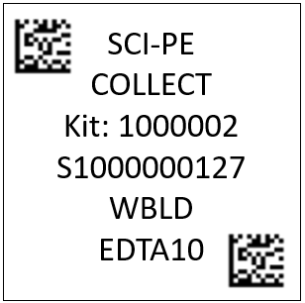
Collection and Aliquot Tube Labels
Study Name
Tube Type
Kit # (unique to the subject and visit)
Specimen Barcode (unique for each tube)
Sample Type
Collection Container
These labels are to be placed on ALL collection tubes. All other labels to be sent to the STAT Lab with samples.

Slide 15
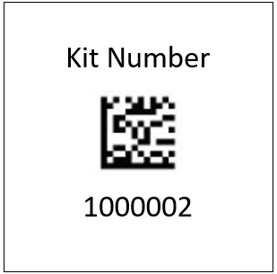
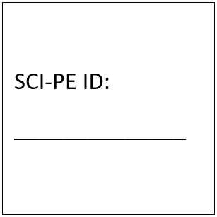

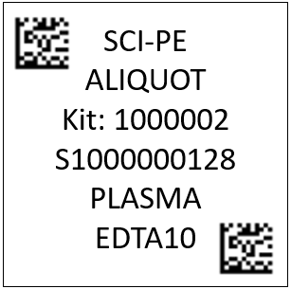
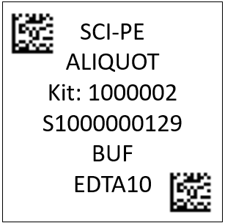
Collection and Aliquot Tube Label Example
Blood Kit Labels Examples
Collection Tube Label
Aliquot Tube Label
Aliquot Tube Label
x4
x4
x2
x7
x2

Slide 16

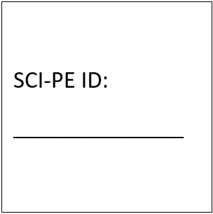
Label Placement for Blood Collection Tubes
Label all collection tubes before collecting, processing, and freezing.
Label only 1 participant’s tubes at a time to avoid mix-ups
Wrap the label around the tube horizontally. Label position is important for all tube types
Make sure the label is completely adhered with no edges coming undone
1. Collection Tube Label
Site ID: _____
RAVE #:
_____________
2. SCI-PE ID Label
INCORRECT
CORRECT

Slide 17
Sample and Processing Forms
Participant and Specimen Information

Slide 18
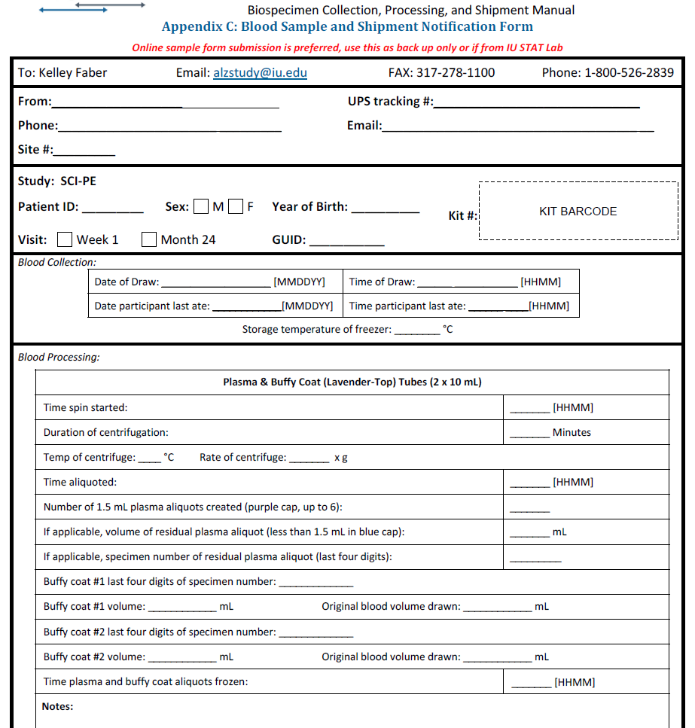
Sample Form
Study Coordinator fills out prior to sending to STAT lab.
STAT lab will fill out then send to NCRAD.

Slide 19
Sample Form
Include in each resealable bag for each participant
Can be found on the SCI-PE NCRAD website or at the end of the MOP
Needs to be filled out prior to sending to the STAT Lab

Slide 20
Sample Shipment
Preparing samples for shipment to NCRAD

Slide 21
Ambient Sample Shipment to STAT Lab
Place labeled EDTAs in the biohazard bag then back in the resealable kit bag with the ‘Tube Station 260’ label
Include copy of the Sample and Processing Form in the outside biohazard sleeve
Send through the Tube Station to Noyes.
Keep a copy of the form for your records
Complete NCRAD Sample Shipment Notification Survey so I can verify that samples were received

Slide 22
Noyes STAT Lab Information
Send the entire kit using tube station #260.
  Tube Station #260 Noyes Address: 1800 N Capitol Ave Suite E200/E202, Indianapolis, IN 46202
  Phone number: 317-278-1178
  There is a bucket with a “NoyesE200/202” label in the tube station room, place the kit there
All kit bags must be labeled so staff knows where it belongs. The kits will come labeled from NCRAD.
Courier Information:
  Company: Velox
  Contact: Dawn McCallister
  Email: dmcallister@veloxexpress.

Slide 23
Advanced Notification
IMPORTANT
The NCRAD Sample Shipment Notification Survey must be filled out prior to shipment
  Please attach the completed Sample and Processing Form for each set of samples within the shipment
  Please fill out the entire survey including contact and tracking information
This is extremely important to make sure samples are:
  received on time to the NCRAD lab
  correctly labeled and organized per patient
  completed and ready for data entry

Slide 24
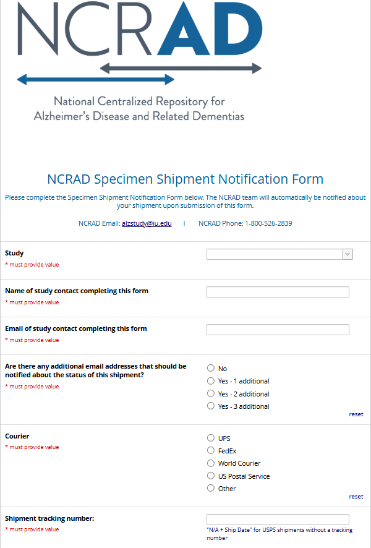
NCRAD Sample
Shipment Notification
1. Ship samples as normal using ShipExec and place the Printable CRFs (from previous slide) in the shipper
2. Go to link:
https://redcap.link/NCRADShippingForm
3. Fill out and Submit Survey

Slide 25
NCRAD Website – SCI-PE Page
Specimen collection overview
Link to kit request module
Online Sample Survey
MOP
Training Slides
Video Tutorials
Shipping Survey
https://ncrad.org/coordinate-studies/SCI-PE

Slide 26
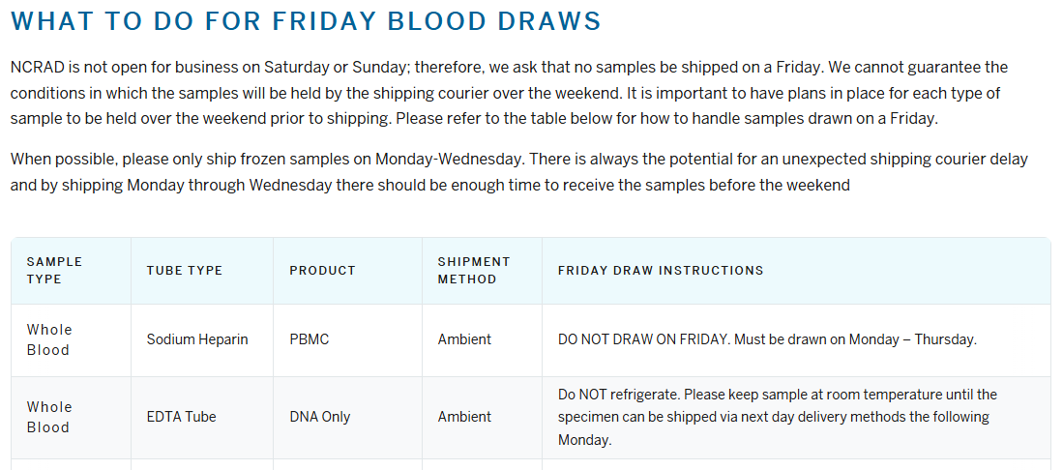
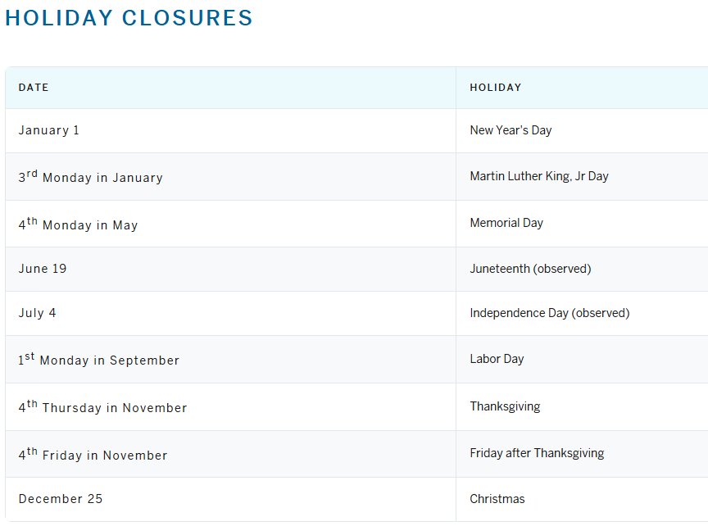
NCRAD Website – Helpful Pages
https://ncrad.org/contact/holiday-closures
https://ncrad.org/contact/friday-blood-draws

Slide 27
FAQ
Q: What should I do with expired supplies, should I send them back?
  A: You do not need to send them back, please dispose of them according to your local guidelines.
Q: How do I know if the STAT lab received the samples I sent?
  A: Please fill out the sample notification survey to inform me which samples and kits were sent. I will be able to check their log and verify what was received!

Slide 28

SCI-PE Contact Information
General Information
  Phone: 1-800-526-2839
  or 317-278-8413
  E-mail: alzstudy@iu.edu
Jazmyn Dickinson – SCI-PE Study Coordinator
E-mail: jazdicki@iu.edu
Corinne Kim - Project Manager
E-mail: kimcor@iu.edu

