Slide 1

DoD-ADBI Collection and Shipment Training

Slide 2
Training Overview: DoD-ADBI
Study Overview
Kit Review
Sample Collection and Processing
Sample Shipping
Sample Forms
NCRAD Website
Common Nonconformance Issues
Questions?

Slide 3
DoD-ABDI Study Specimens
Biofluids Collection Schedule
Timepoint | Plasma | Buffy Coat | RNA
All Visits | X | X | X

Slide 4
Kit Request Module
Website: kits.iu.edu/DOD-ADBI

Slide 5
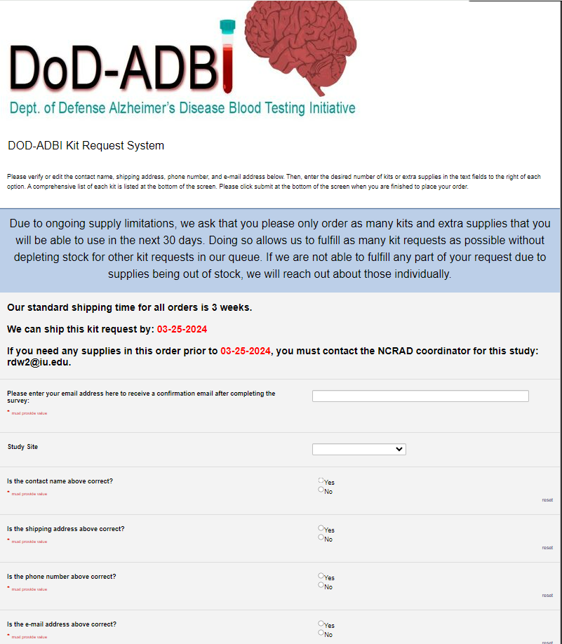
NCRAD Kit Request Module
Choose your site from the drop-down list.
The coordinator name and contact information will appear.
Verify that this information is accurate or correct it if necessary.

Slide 6
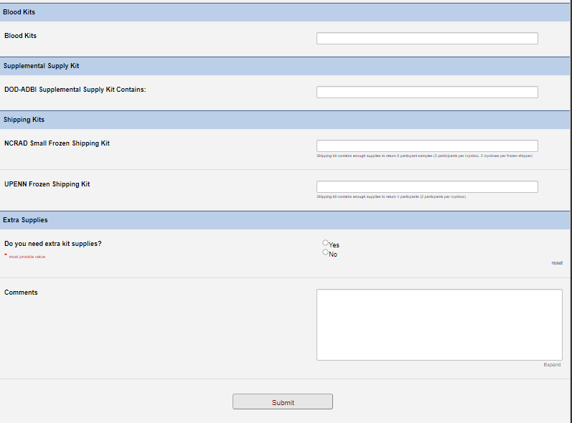
DoD-ADBI Blood Kits
Indicate the quantity needed of each kit
**Note: You can order more than one type of kit in a single kit request**
1

Slide 7
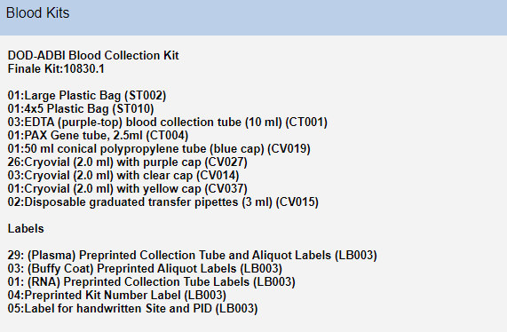
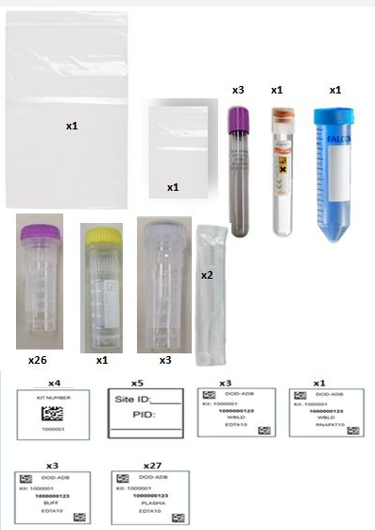
DoD-ADBI Blood Kits
Once selected, kit components with a picture of the chosen kit will appear at the bottom of the screen (Pictured)
Click “Submit” to turn in your request.

Slide 8
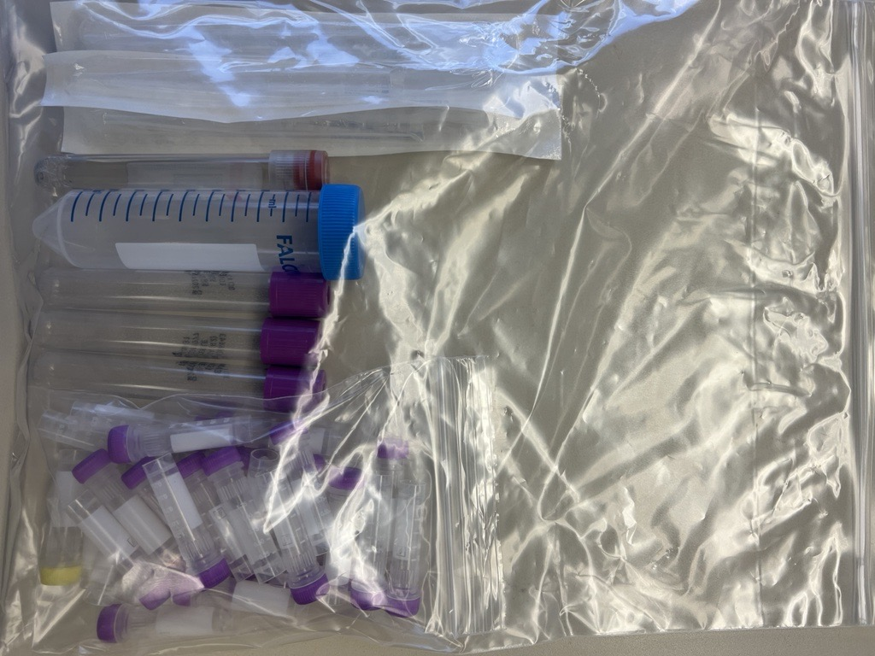
DoD-ADBI Blood Kits Example Kit

Slide 9
DoD-ADBI Supplemental Kits
Remember: Only one supplemental kit per year. If extra supplies are needed, order separately under the “Extra Supplies”.
Order here if extra supplies are needed.

Slide 10
Specimen Labels

Slide 11

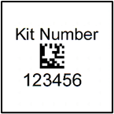
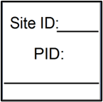
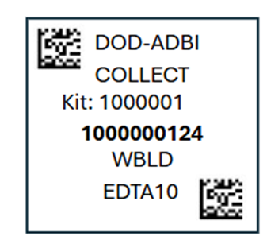
Three Label Types
Kit Number
Site ID/PID
Collection Tube and Aliquot Label

Slide 12
Kit Number Labels
Used to track patient samples and provide quality assurance – Will be placed on the following locations :
Blood Sample and Shipment Notification Forms
Cryoboxes that houses aliquots during shipping
One extra label provided
Provided by NCRAD in the kits

Slide 13
Site ID Labels
Subjects will be identified by their DoD-ADBI PID
Sites will be responsible for handwriting this onto the provided labels
Must use Fine Point Marker
Each site will receive 3 markers in initial kit supply
Provided by NCRAD in the kits

Slide 14
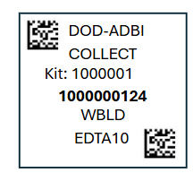
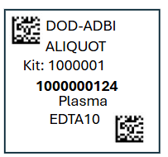
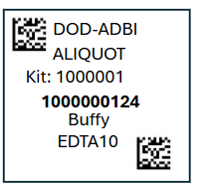

Collection Tube and Aliquot Label – Plasma and Buffy Coat
Only one label to be placed on ALL aliquot tubes
Collection Tube Label
Plasma Aliquot
  From EDTA tube sent to C2N and UPENN
Buffy Coat Aliquot
  From EDTA tube Sent to NCRAD
Collection Tube Plasma Aliquot

Slide 15
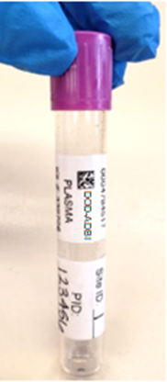
Labeled EDTA (Purple-Top) Blood Collection Tube
Collection Tube/Aliquot Label
Site and PID Label

Slide 16
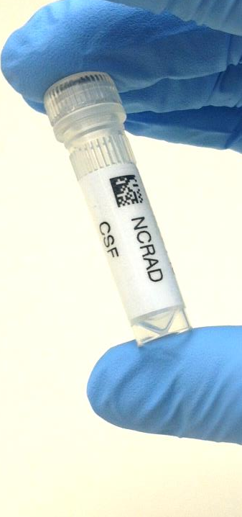
Specimen Labels –
Plasma and Buffy Coat
Specimen tube label only
Please place barcode near cap

Slide 17
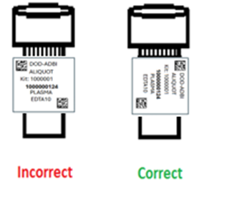
Labeling Biologic Samples
Please...
Label all collection and aliquot tubes before cooling, collecting, processing or freezing samples
Label only 1 subject’s tubes at a time to avoid mix-ups
Wrap the label around the tube horizontally. Label position is important for all tube types
Make sure the label is completely adhered by rolling between your fingers

Slide 18
Handling/Processing
Study Specimens

Slide 19
Blood Draw Order
FASTING OVERNIGHT (MINIMUM 6 HOURS) IS REQUIRED FOR PLASMA SAMPLE COLLECTION. ONLY WATER IS PERMITTED UNTIL THESE BLOOD DRAWS ARE COMPLETED.
Draw Order | Collection Tube | Drawn At | Specimen Type | Aliquot Volume | Total Number of Aliquots | Shipping Destination | Shipping Temperature
1 | 3 EDTA (Purple-Top) Blood Collection Tubes (10 ml) | Each visit | Plasma | 1.8 ml | 1 | UPenn | Frozen
 |  |  | Plasma | 0.5 ml | Up to 26 | UPenn | Frozen
 |  |  | Buffy Coat | ~1.0 ml | Up to 3 | NCRAD | Frozen
2 | 1 PAXgeneTM Blood Collection Tube (2.5 ml) | Each visit | Whole Blood | N/A | N/A | NCRAD | Frozen

Slide 20

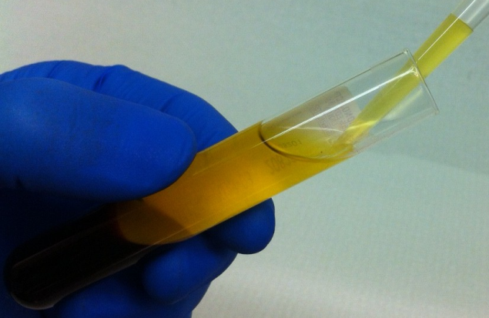
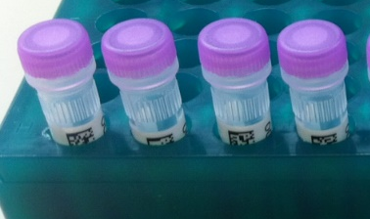
Plasma Collection
Create up to 8 aliquots
Please Note: For DOD-ADBI there could be up to eight 0.5ml aliquots created per 10ml EDTA tube. Please refer to the blood process schematic.

Slide 21







Plasma and Buffy Coat Preparation (10ml Lavender-Top Tube x 3)
Step One
Step Two
Step Three
Step Four
Step Five
Aliquot First 1.8ml
Step Six
Adhere preprinted labels to the yellow cryovial & purple cap cryovials.
First Aliquot 1.8 ml into yellow cryovial.
Aliquot 0.5 ml into each purple cryovial tube.
Store plasma aliquots at -80°C until shipment.
x 26
Step Seven
Store tubes at room temp.
Check expiration date on collection tubes.
Label tubes with preprinted labels prior to blood draw.
Collect blood in EDTA Tubes allowing blood to flow for 10 seconds and ensuring blood flow has stopped.
Immediately after blood draw, invert tubes 8-10 times to mix samples.
Centrifuge samples at 1500 RCF (x g) at RT for 15 minutes.
Samples need to be spun, aliquoted, and in the freezer within 60 minutes from the time of collection.
Adhere preprinted labels to the clear cap cryovials.
Using a clean pipette tip, collect the buffy coats (may have residual plasma and some RBCs included).
Transfer the buffy coats into the cryovial tubes.
Store buffy coat aliquots at -80°C until shipment.
Pool all plasma from the 3 EDTA tubes into a 50ml conical tube and invert gently 3 times to mix the plasma.

Slide 22
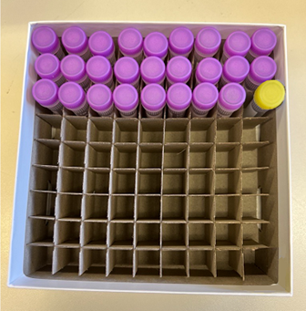
Cryovial Cap Colors (Samples going to C2N & UPENN)
Purple Cryovial going to UPENN
Yellow Cryovial going to C2N
Remember: Plasma Aliquots (up to 27) per each study participant for shipment to UPENN. Up to 2 Study Participants per cryobox.

Slide 23
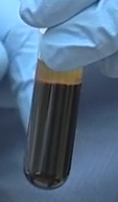

Buffy Coat Collection

Slide 24
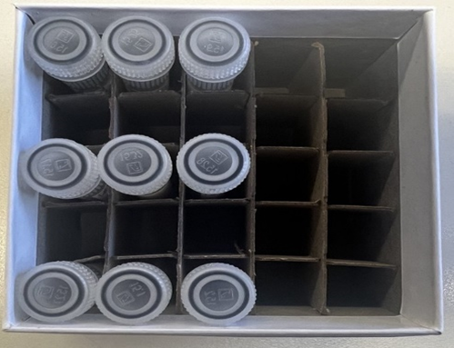
Cryovial Cap Colors (Samples going to NCRAD)
Clear Cryovial going to NCRAD
Remember: Buffy Coats (3) per each study participant for shipment to NCRAD. Up to 3 Study Participants per cryobox

Slide 25
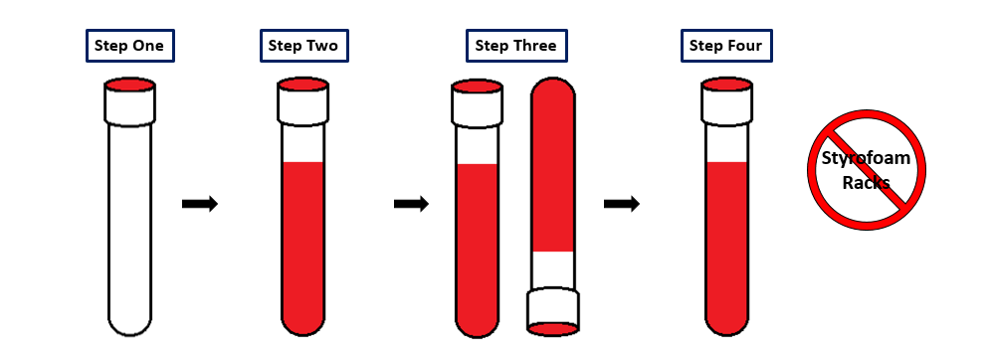
RNA PAXgene™ Collection
Store tubes at room temp.
Check expiration date on collection tubes.
Label tubes with preprinted labels prior to blood draw.
Collect blood in PAXgeneTM tube allowing blood to flow for 10 seconds, and ensuring blood flow has stopped.
Immediately after blood draw, invert tube 8-10 times to mix sample.
Store tubes in wire rack at -80°C until shipment to NCRAD.
Do not store tube in Styrofoam racks.

Slide 26
Sample Shipments to NCRAD

Slide 27
Sample Shipments Summary

Slide 28
Frozen Shipment Packaging
Samples shipped frozen to NCRAD
  Buffy Coat and PAXgeneTM
  Ship Monday-Wednesday Only
Hold packaged samples in a -80°C freezer until pickup.
Include copy of Blood Sample Shipment and Notification Form
Batch samples together
  6 participant samples or 2 cryoboxes with 3 participants each (Buffy Coat)
  Batch shipping should be performed quarterly or as a full shipment of specimens accumulates, whichever is sooner.

Slide 29
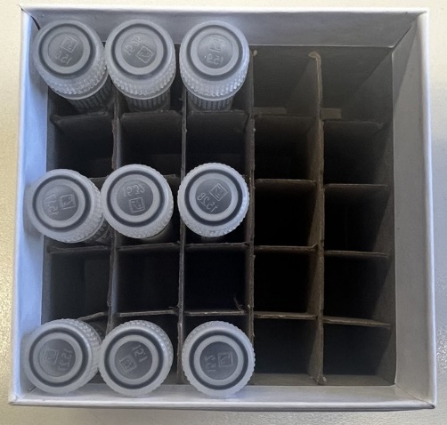
Shipping Frozen Samples
Buffy Coats (3) Per each Study Participant
Up to 3 Study Participants per cryobox

Slide 30
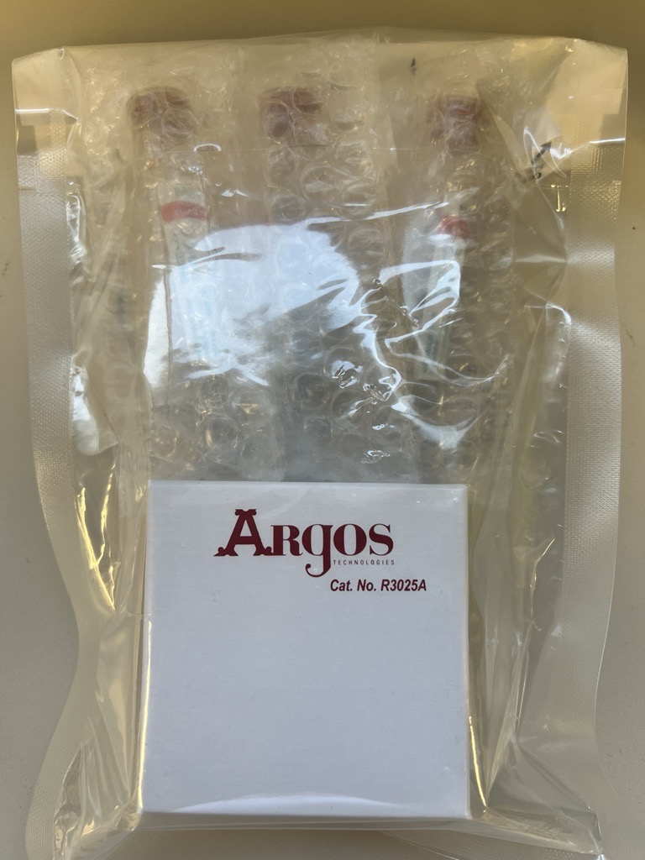
Frozen Shipment Packaging
Use the biohazard bag to package the (1) 25-Slot Cryobox and (3) Pax gene tubes in bubble sleeves.
Please make sure that all samples that are frozen and returned to NCRAD are in an upright position .
(3) Pax gene TM tubes in bubble sleeves.
(1) 25-Slot Cryobox
Cryovial box and Pax Gene Tubes in bubble sleeves placed in clear biohazard bag

Slide 31
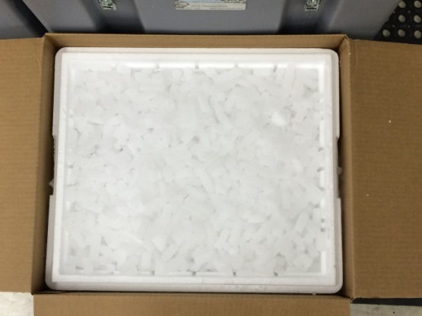
Frozen Shipping Packaging
Place 2-3 inches of dry ice in the bottom of the Styrofoam shipping container, then insert the cryoboxes laying upright.
Fully cover the cryoboxes with additional dry ice, and if possible, completely fill the shipper with pelleted dry ice.
Each Styrofoam shipper must contain about 10lbs (20 kg) of dry ice.

Slide 32
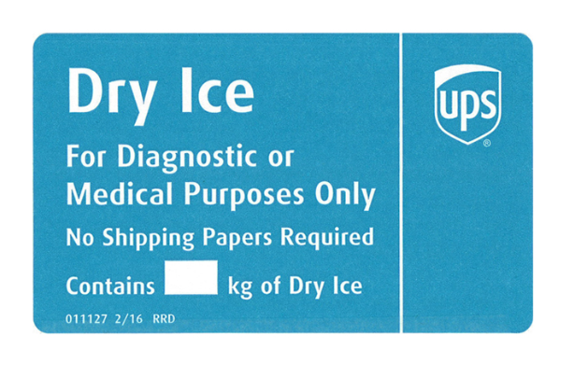
Frozen Shipping – Dry Ice Requirements
Dry Ice label should not be covered with other stickers and must be completed or the shipping carrier will reject/return your package!
Net weight of dry ice in kg
5

Slide 33
Blood Sample and Shipment Notification Form
A copy of the sample form must be emailed to NCRAD prior to the date of sample arrival.
Please include sample forms in all shipments of frozen.
Email: alzstudy@iu.edu

Slide 34
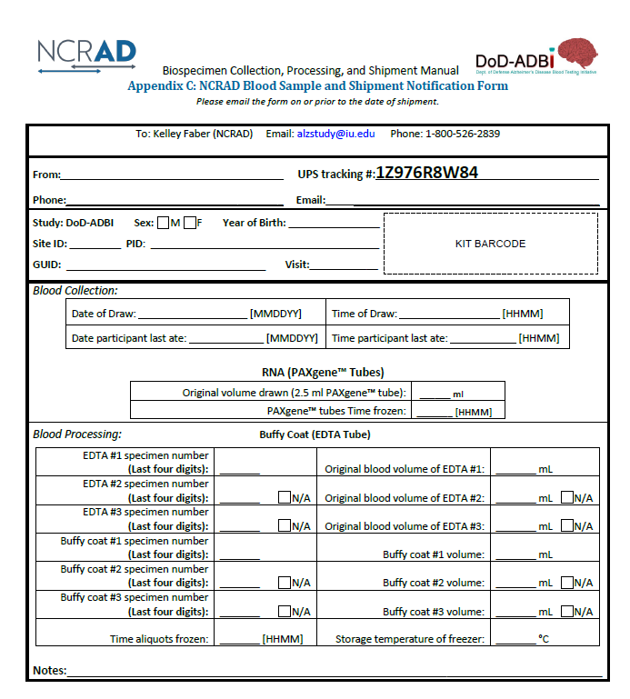
NCRAD Blood Sample and Shipment Notification Form

Slide 35

Sample Shipments to UPenn

Slide 36
UPenn Frozen Shipment Packaging
Samples shipped frozen to UPenn
  Plasma
  Ship Monday-Wednesday Only
Hold packaged samples in a -80°C freezer until pickup.
Include copy of Blood Sample Shipment and Notification Form
NCRAD will include preprinted UPS return airbills for shipments to UPenn in the UPenn Frozen Shipping Kits.
Once the frozen shipment package is prepared, peel of the backing of the airbill and adhered the label onto the shipping box.
Please ensure that the UPS airbill sticker does not cover any of the warning labels (e.g. dry ice label or UN3373) or overlap taped seams.
Batch samples together
  4 study participant samples or 2 cryoboxes with 2 participants each (Plasma)

Slide 37
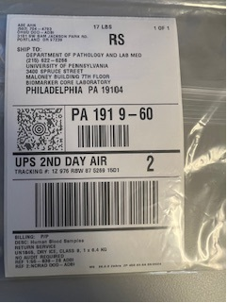
UPenn Frozen Shipment Packaging
This is an image of the UPS return Airbill that will be provided by NCRAD. This label will be use by study sites to ship samples to UPenn. These labels are pre-made by the NCRAD team that includes the Study Site information as the sender and the ship to information as all UPenn’s information.
*Please note that all UPenn Frozen Shipping kits will include the UPS return airbill to ship to UPenn.*

Slide 38
Shipping Frozen Samples
Plasma Aliquots (up to 27) per each study participant for shipment to UPENN. Up to 2 Study Participants per cryobox.

Slide 39
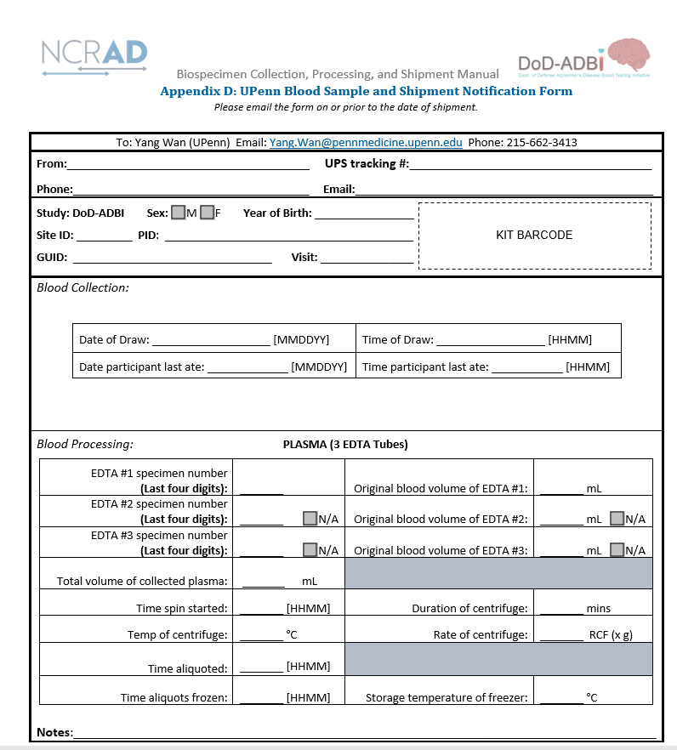

UPenn Blood Sample and Shipment Notification Form

Slide 40
Blood Sample and Shipment Notification Form
A copy of the sample form must be emailed to UPenn prior to the date of sample arrival.
Please include sample forms in all shipments of frozen.
Email Manifest to: Yang.Wan@pennmedicine.upenn.edu with “DoD ADBI” in the subject line in include the UPS tracking number.

Slide 41
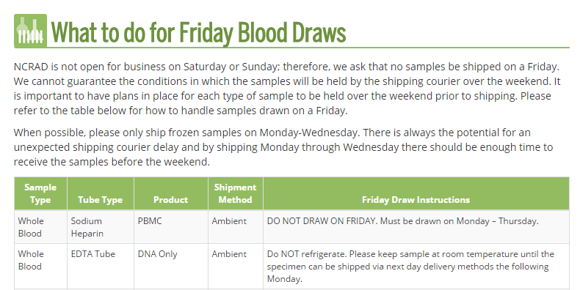
NCRAD Website
Helpful Pages
https://ncrad.iu.edu/contact/friday-blood-draws
https://ncrad.iu.edu/contact/holiday-closures
Date | Holiday
January 1 | New Year’s Day
3rd Monday in January | Martin Luther King, Jr Day
4th Monday in May | Memorial Day
June 19 | Juneteenth
July 4 | Independence Day
1st Monday in September | Labor Day
4th Thursday in November | Thanksgiving
4th Friday in November | Friday after Thanksgiving
December 25 | Christmas Day

Slide 42
Nonconformance Issues
Recommendation:
Place aliquots in Argos boxes/tube rack in freezer upright until shipment
Sample aliquots and collection tubes frozen at an angle/inverted
Fields left blank on Blood Sample and Shipment Notification Forms
    Last time participant ate often left blank/unknown
Incorrect data reported on Sample and Shipment Notification Forms
Multiple low volume aliquots
Recommendation: Complete Sample Notification forms during the participant study visit as samples are processed. If participant can not provide fasting info please write in N/A
Recommendation:
Lay out cryovials in a row and aliquot in order until plasma/buffy coat is depleted

Slide 43
Nonconformance Cont.
Aliquots arriving to NCRAD without labels
Sample forms not faxed or scanned to NCRAD the day before shipment
Recommendation:
Ship Samples to NCRAD utilizing the Notification Form, by DoD-ADBI ID. Do not throw away labels until samples are packed and shipped.

Slide 44
Contact Information
Questions?
  Ronae Williams
    Phone: (317) 278-9082
    E-mail: rdw2@iu.edu
  General NCRAD Contact
    Phone: (800) 526-2839
    E-mail: alzstudy@iu.edu
    Website: www.ncrad.iu.edu

