Slide 1

A Clinical Trial to Evaluate the Effect of Equol, a Dietary Supplement, on Arterial Stiffness, Small Vessel Disease in the Brain and Cognitive Decline in Healthy Volunteers – Phase 2
(ACE)
&
The National Centralized Repository for Alzheimer’s Disease and Related Dementias (NCRAD)

Slide 2
Contact Information
Questions?
Please contact NCRAD Coordinator at:
  Phone: 317-274-7890
  CRC email: dlkeys@iu.edu
  Back-up email: alzstudy@iu.edu
  Website: www.ncrad.org

Slide 3
Training Overview:
Pre-intervention and Blood-Based Collection Schedule
Kit Request Module
Specimen Labels
Handling/Processing Study Specimens
Sample Shipping
NCRAD Website
Questions?

Slide 4
ACE Biofluid Collection Schedule
Specimen Type | Pre-intervention Visit
Urine | X
Notes:
Whole blood is collected in three types of tubes (10ml Serum-Separator/SST Tube, 10ml lavender-top EDTA tube and 6ml EDTA tube). The 10ml red-top serum separator tube is processed locally into serum and then aliquoted, frozen at the study site and shipped to NCRAD. The 10ml EDTA tubes are processed locally into plasma and buffy coat fractions. They are then aliquoted, frozen at the study site, and shipped to NCRAD. The 6ml EDTA tube is frozen locally without further processing and shipped to NCRAD.

Slide 5
ACE Biofluid Collection Schedule
Specimen Type | Baseline Visit | 12 Month Visit | 24 Month Visit
Serum | X | X | X
Plasma | X | X | X
Buffy Coat (DNA extraction) | X | X | X
Stool | X | X | X
Notes:
Whole blood is collected in three types of tubes (10ml Serum-Separator/SST Tube, 10ml lavender-top EDTA tube and 6ml EDTA tube). The 10ml red-top serum separator tube is processed locally into serum and then aliquoted, frozen at the study site and shipped to NCRAD. The 10ml EDTA tubes are processed locally into plasma and buffy coat fractions. They are then aliquoted, frozen at the study site, and shipped to NCRAD. The 6ml EDTA tube is frozen locally without further processing and shipped to NCRAD.

Slide 6
Kit Request Module
kits.iu.edu/ACE

Slide 7
Kit Request Module
An initial stock of kits will be delivered prior to the designated site-specific start date.
Kits and individual supplies are available to order:
  Pre-intervention (Urine) Kit
  Stool/Blood-Based Kit
  Urine Supplemental Supply Kit (1 only per year)
  Stool/Blood-Based Supplemental Supply Kit (1 only per year)
  Frozen Blood Shipping Supply Kit
  Ambient Stool Shipping Supply Kit
  Individual Supplies

Slide 8
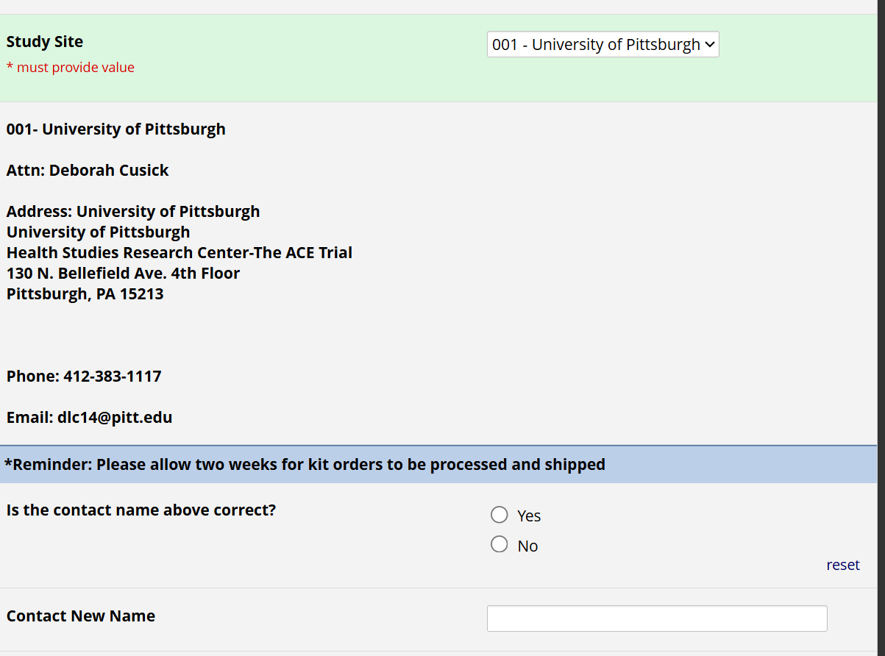
NCRAD Kit Request Module
Choose your site from the drop down list
The coordinator name and contact information will appear
Verify that this information is accurate, correct if necessary

Slide 9
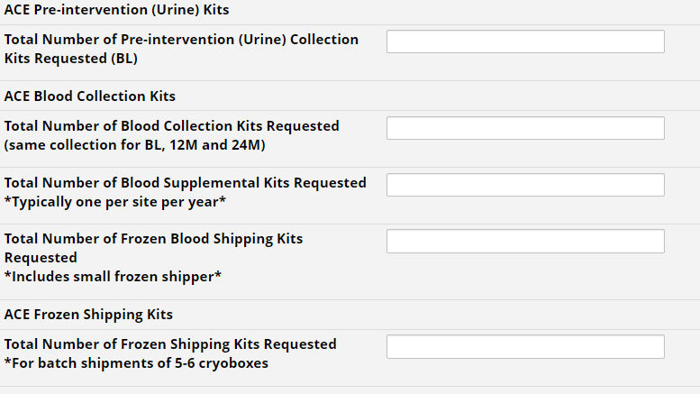
Kits Available
Pending link when HEAD added to NCRAD.ORG

Slide 10
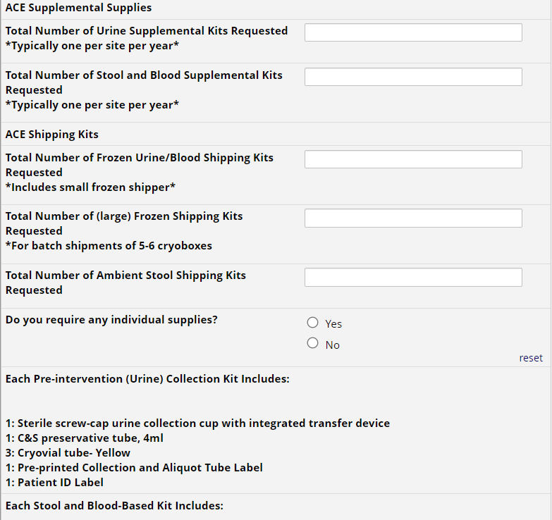
Study Visit Kits
Indicate the quantity needed of each kit
Once selected, kit components of the chosen kit will appear at the bottom of the screen (Pictured)
Click “Submit” to turn in your request.
The IU staff will notify you that your request has been received and address any issues.
**Note: You can order more than one type of kit in a single kit request**

Slide 11
NCRAD Kit Request Module: When It Must be Used
Each site will be responsible for ordering kits (labels included) and maintaining supplies on site for scheduled participants
To order, sites will use the Indiana University online kit ordering module: kits.iu.edu/ACE
Allow a minimum of 3 weeks for your order to be processed and delivered.

Slide 12
Specimen Labels

Slide 13
Label Type Summary
Kit Number Labels
PTID Labels
Collection Tube and Aliquot Tube Labels
  Differ by specimen type, collection tube, and aliquot tube

Slide 14

Kit Number Labels
Used to track patient samples and provide quality assurance
Will be placed on the following locations:
  Biological Sample and Shipment Notification Form
  Outside cryobox that houses aliquot tubes during storage and shipment
  Provided by NCRAD in the kits

Slide 15
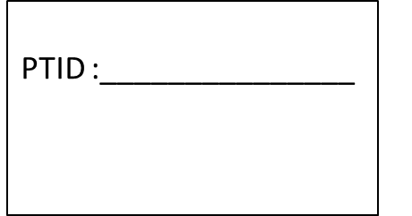
PTID Label
Subjects will be identified by their PTID
The PTID may only be available shortly before the visit
Sites will be responsible for handwriting this onto the provided labels
Must use Fine point permanent marker

Slide 16
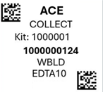
Collection & Aliquot Tube Labels
Study name
Kit Number (assigned by NCRAD)
Specimen barcode (assigned by NCRAD
Specimen type

Slide 17



Collection & Aliquot Tubes - Blood
Label 1: Collection & Aliquot Tube Label
Label 2: PTID Label
BUFFY
Collection/Aliquot
tube label *place barcode near top
All collection tubes will have two labels
  The Collection & Aliquot Tube Label
  The handwritten PTID Label
PTID label
*place label near bottom

Slide 18

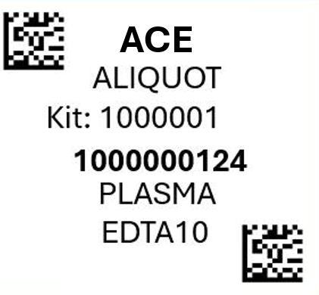
Collection & Aliquot Tube Labels –
Serum, Plasma, Buffy Coat, and Urine
PLASMA
Collection and Aliquot tube label only
Notes:
Need new photo of micronic

Slide 19
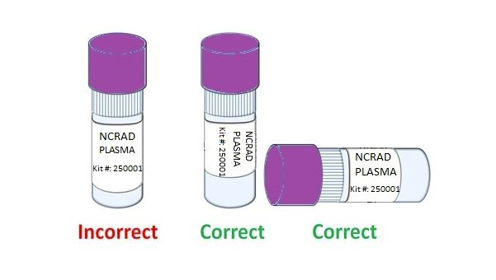
Labeling Biologic Samples
Please...
Label all collection and aliquot tubes before cooling, collecting, processing or freezing samples.
Label only 1 subject’s tubes at a time to avoid mix-ups.
Wrap the label around the tube horizontally. Label position is important for all tube types.
Make sure the label is completely adhered by rolling between your fingers.
Notes:
Is this accurate for the micronic tubes? ADD EXAMPLE OF collection tube as well!

Slide 20
Handling/Processing
Study Specimens

Slide 21
Site Required Equipment
Blood Collection/Safety Equipment
Processing/Storage Equipment
PPE
  Lab Coat, Safety Glasses
Tourniquet
Alcohol Prep Pad
Gauze Pad
Butterfly Needles
Bandage
Sharps Bin and Lid
Centrifuge capable of ≥2000 rcf with refrigeration to 4⁰C
-80⁰C Freezer
Wet Ice Bucket
Notes:
Confirm if all needed for this study

Slide 22
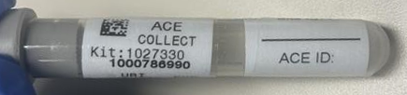
Sample Collection – Pre-intervention Visit (Urine BL)
Draw Tube Order | Tube Type | Number of Tubes Drawn | Tube Image
1 | C & S Preservative Tube (Gray-Top) Urine Collection Tube (4 ml) | 1
Notes:
UPDATE?

Slide 23


Sample Collection – Blood (Site)
Draw Tube Order | Tube Type | Number of Tubes Drawn | Tube Image
1 | Serum (Red-Top) Tube (10 ml) | 1
2 | EDTA (Lavender-Top) Tube (10ml) | 2
Notes:
UPDATE?

Slide 24


Sample Collection – Stool (Participant)
Draw Tube Order | Tube Type | Number of Tubes Drawn | Tube Image
1 | (ME-200) Purple-Top Stool Collection Tube | 1
2 | (OMR-200) Purple-Top Stool Collection Tube | 1
Notes:
UPDATE?

Slide 25

Aliquot Cap Colors
Cap Color | Sample Type
Red Cap | Serum
Purple Cap | Plasma
Blue Cap | Plasma Residual (<1.5ml) (Document Specimen Number and Volume of Residual Aliquot on Sample Form)
Clear Cap | Buffy Coat
Yellow Cap | Urine
Red Cap (Serum)
Purple Cap (Plasma)
Blue
Cap (Residual)
Clear Cap (Buffy Coat)
Yellow Cap (Buffy Coat)

Slide 26


Pre-intervention (Urine) Collection Instructions
Label cryovials with collection tube/aliquot tube labels.
Using a clean transfer pipette, aliquot 1.5 ml into each cryovial.
Place urine sample aliquots in cryobox at -80°C until shipment.
Store tubes and urine cup at at room temp.
Label tube and Urine cup with collection tube/aliquot tube labels and PTID labels.
Please instruct subject to complete a midstream clean-catch collection urine sample in the urine cup.
Pierce the urine cup’s integrated transfer port needle with the urine gray-top tube to initiate vacuuming of the urine sample.
Once the urine gray-top tube has been penetrated by the integrated transfer port, allow the sample to vacuum into the urine tube.

Slide 27
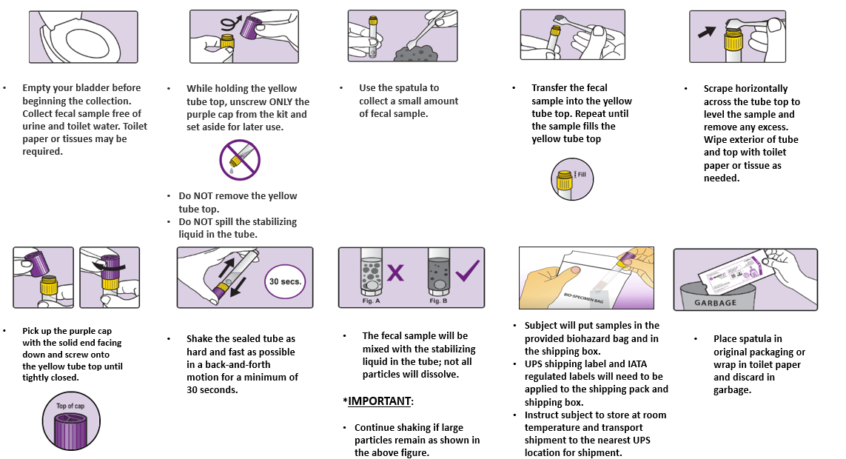
At-Home Stool Collection Instructions

Slide 28
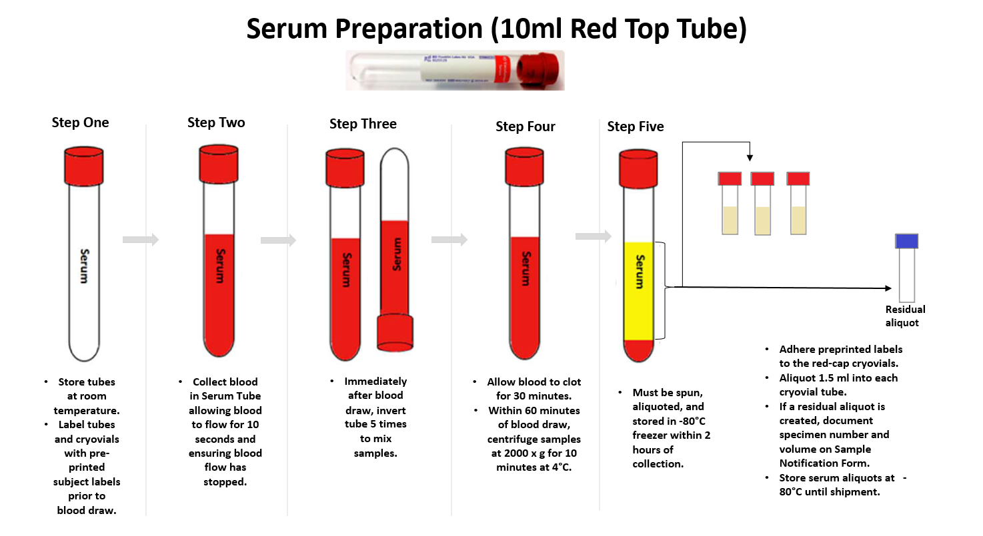

Slide 29
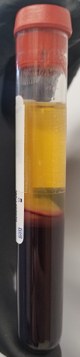

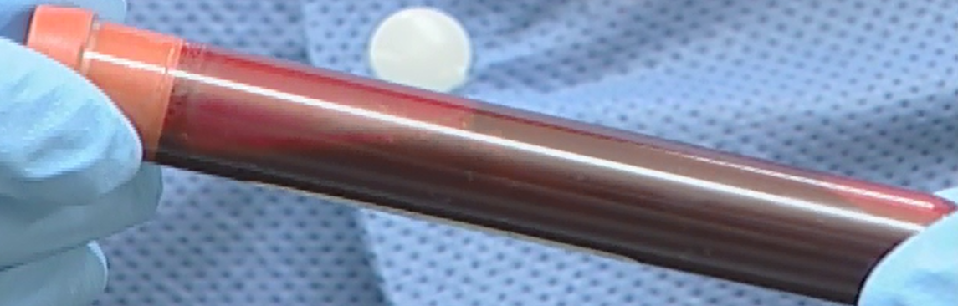
Serum Tube (Serum Collection)
** Please note: After standing at room temperature for 30 minutes, blood will be clotted and immobile**
Serum Tube (unfilled)
Serum Tube (after centrifuge)

Slide 30
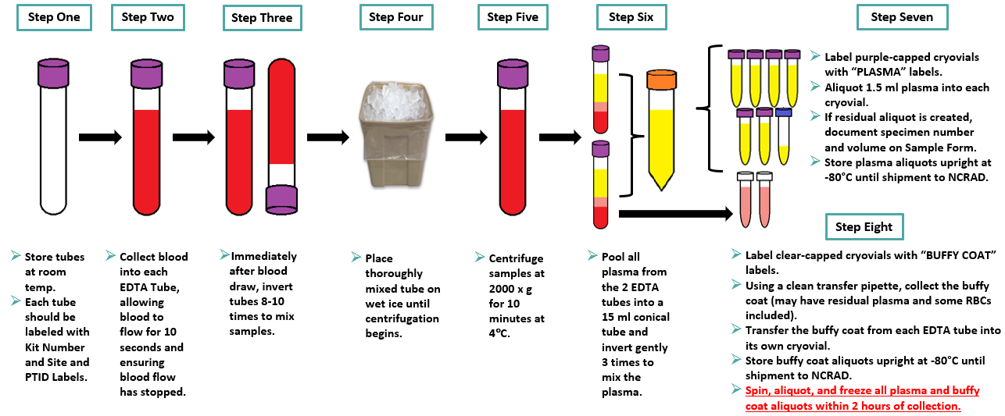
Plasma and Buffy Coat Preparation EDTA Purple-Top Tube (2 x 10 ml)

Slide 31
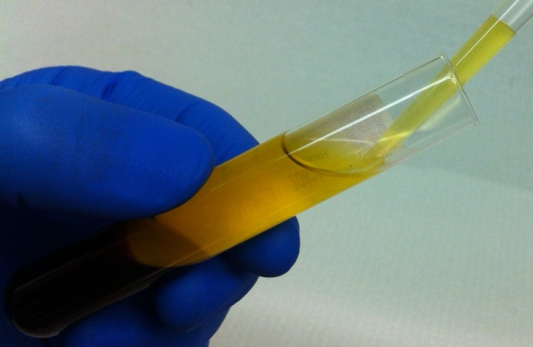

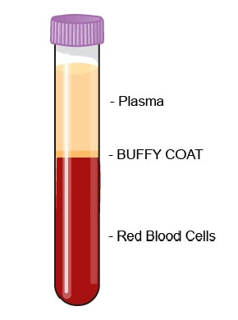
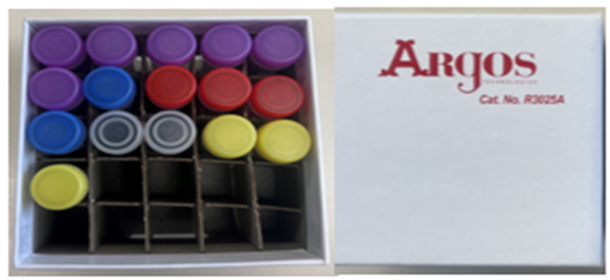

EDTA Tube (Plasma Collection)
Close up view of 2.0 ml cryovial
Plasma Aliquots (up to 7 possible)
Notes:
UPDATED PHOTOS IN NEW CRYOBOX FOR MICRONICS?

Slide 32
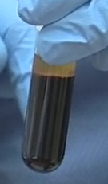

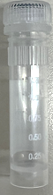
EDTA Tube (Buffy Coat Collection)
Important Note:
Buffy Coat aliquots will be distinguished from the plasma aliquots through a gray cap.

Slide 33
Sample Shipping

Slide 34
Stool Sample Shipment Summary
Draw Tube Order | Sample Type | Tube Type | Number of Tubes Supplied in Kit | Aliquot Volume | Tubes to NCRAD | Ship (Shipped by Subject)
N/A | Stool | ME-200 + OMR-200 Bundle option | 2 | N/A | 2 | Ambient
**Shipped by subject via USPS

Slide 35
Ambient Sample Shipment
Stool Collection Tubes (OMR-200 & ME-200)
Samples must be mailed out same day of collection.
Monday-Thursday shipping ONLY
Site coordinator MUST:
Label the stool collection tubes for the subject
Complete top portion of form INCLUDING TRACKING NUMBER prior to sending kit home with participant copy of Biological Sample Shipment and Notification Form
Apply the USPS Express shipping label and Exempt Human Specimen label to the outside of the box (do not cover up any shipping labels)

Slide 36
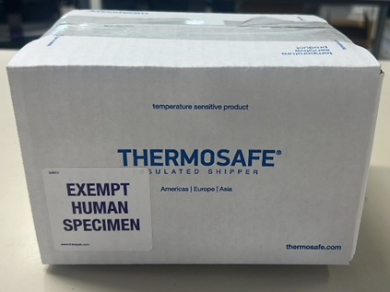
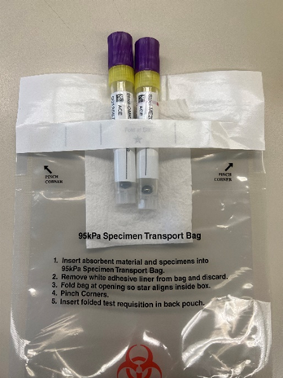
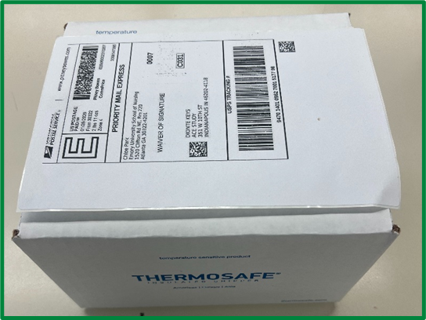
Ambient Sample Shipment

Slide 37
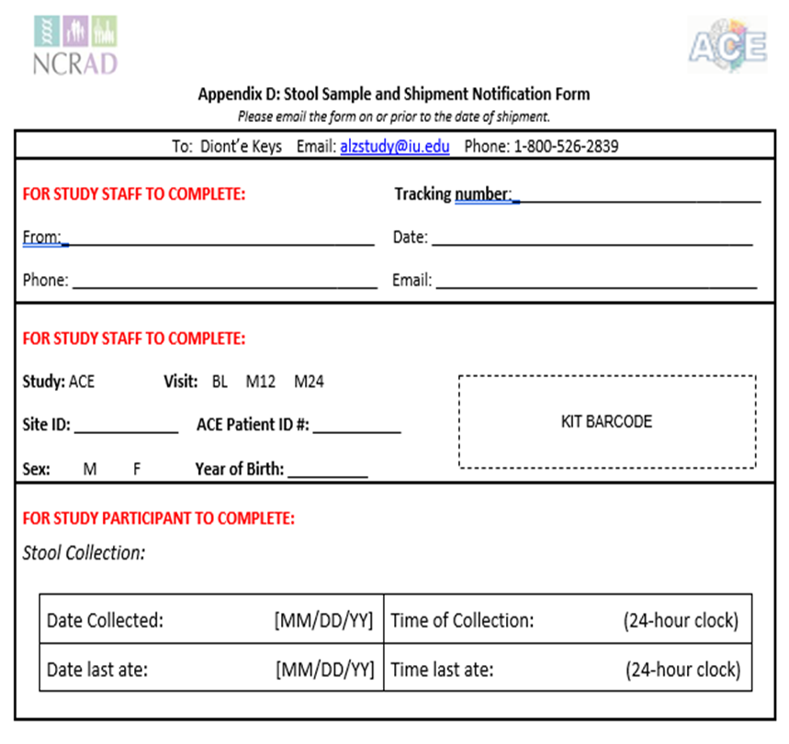

Shipping Ambient Samples
Have subject place ambient shipper containing stool samples in the designated area where their daily mail is picked up by the USPS.
Have subject record date and time and place Biological Sample and Shipment Notification Form inside of ambient shipper before closing the box
  **Site Personnel: Email: alzstudy@iu.edu
    cc: dlkeys@iupui.edu

Slide 38
Blood and Urine Sample Shipment Summary (Frozen)
Draw Tube Order | Sample Type | Tube Type | Tubes to NCRAD | Ship
1 | Urine | URINE: 2.0 ml cryovials with yellow cap | 3 | Frozen
2 | Whole blood for isolation for serum | SERUM: 2.0 ml cryovials with red cap (residual volume placed in 2.0 ml cryovial with blue cap) | Up to 4 | Frozen
3 | Whole blood for isolation of plasma & buffy coat (for DNA extraction) | PLASMA: 2.0 ml cryovials with purple cap (residual volume placed in 2.0 ml cryovial with blue cap) | Up to 7 | Frozen
 |  | BUFFY COAT: 2.0 ml cryovial | 2 | Frozen

Slide 39
Frozen Sample Shipping
Ship Monday-Wednesday Only
  Plasma
  Buffy Coat
  Serum
  Urine
Hold packaged samples in a -80°C freezer until pickup.
Batch Samples together
  5 cryoboxes
  Batch shipping should be performed quarterly or as a full shipment of specimens accumulates, whichever is sooner.
Notes:
Which samples are sent frozen vs ambient??

Slide 40
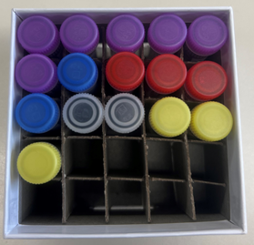
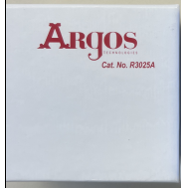
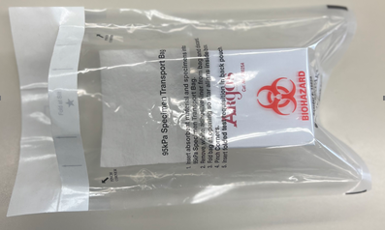
Frozen Shipping - Cryoboxes
Place cryobox in one Biohazard Bag with absorbent sheet.
Place aliquoted tubes in cardboard cryobox
Notes:
Updated photos: pending decision on micronic cryobox or original cryobox

Slide 41

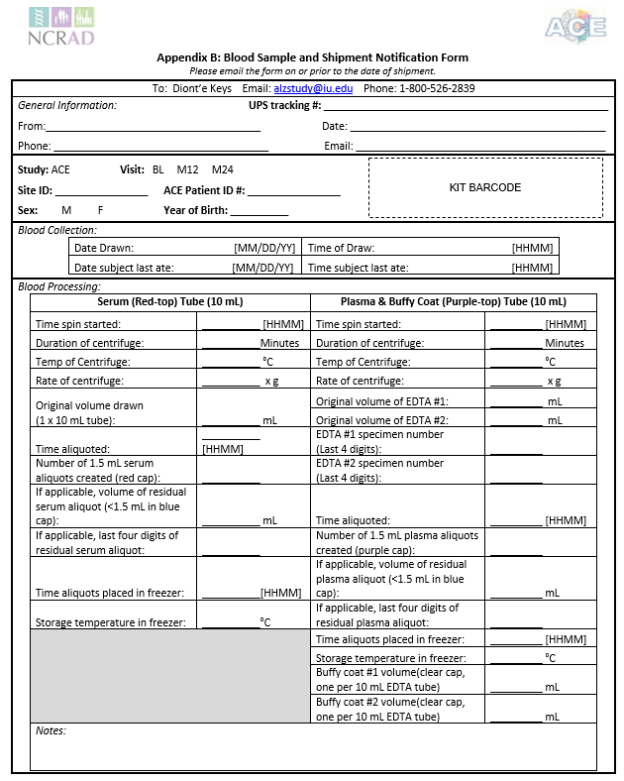
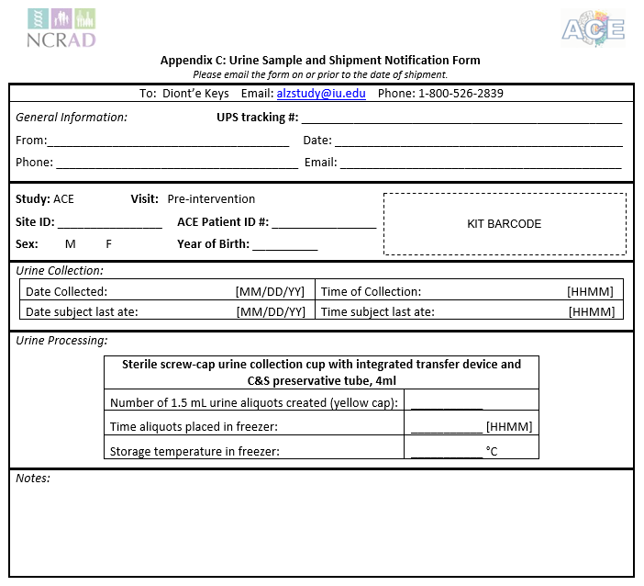
Shipping Frozen Samples
Schedule UPS
Send Biological Sample and Shipment Notification Forms (Urine/Blood) to IU (US) ahead of shipment
  Email: alzstudy@iu.edu
    cc: dlkeys@iupui.edu

Slide 42
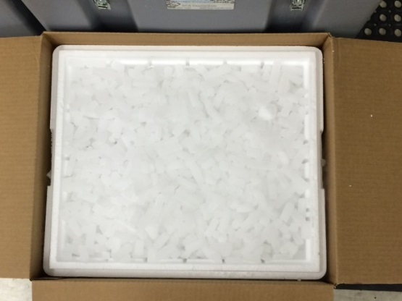
Frozen Shipping – Dry Ice Requirements
Fully cover the cryoboxes with about 2 inches of pelleted dry ice in the provided shipper.
Each Styrofoam shipper must contain about 45 lbs (20 kg) of dry ice.

Slide 43
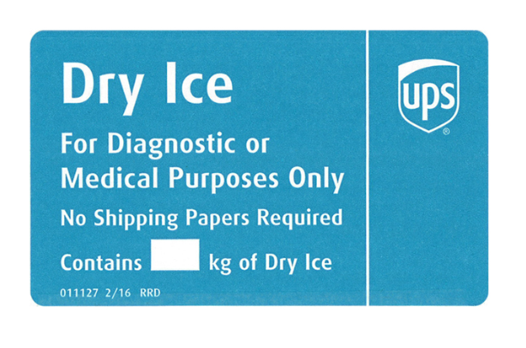
Frozen Shipping – Dry Ice Requirements
Dry Ice label should not be covered with other stickers and must be completed or the shipping carrier will reject/return your package!
Net weight of dry ice in kg
20.4

Slide 44
UPS ShipExec System
Log into the ShipExec Thin Client at https://kits.iu.edu/ups
  If a new user or contact needs access, please reach out to your study contact for access
Follow instructions on section 8.2 of ACE Manual of Procedures to create your return airbill and schedule a UPS pickup

Slide 45
Shipping Regulations and Training
PLEASE NOTE:
All study personnel responsible for shipping should be certified in biospecimen shipping.
It is the responsibility of each site to ensure that the appropriate training has been provided and conducted in regards to IATA shipping.

Slide 46
UN3373 Biological Substance, Category B Training
Biological Substance, Category B are specimens being transported for “investigational purposes”
Recommend: investigator sites document training of category B/dangerous goods
We recommend establishing a record of your staff’s training and date of instruction
The training records must be made available upon request by the appropriate national authority
  Additional information from the Department of Transportation (DOT) can be found on their website http://hazmat.dot.gov

Slide 47
Biological Sample and Shipment Notification Forms
A copy of the sample form must be emailed to NCRAD prior to the date of sample arrival.
Please include sample forms in all shipments of frozen and ambient samples.
Email: alzstudy@iu.edu

Slide 48

Biological Sample Notification Form- Urine
Urine collected for:
  Urinalysis
  **Site Personnel: Place the kit number label in the designated area suggested
Send by E-mail and include a copy in each shipment

Slide 49

Biological Sample Notification Form- Blood
Blood collected for:
  Serum
  Plasma
  Buffy Coat/DNA
  **Site Personnel: Place the kit number label in the designated area suggested and record the barcode on the residual cryovial tube beneath the kit number label (permitting there is a residual).
Send by E-mail and include a copy in each shipment

Slide 50


Biological Sample Notification Form- Stool
Stool collected for:
  Fecal metabolomics
  Form will partially be completed by site personnel
  Remember to document the tracking number
  Subject will complete second portion of the form after collection.
  **Site Personnel: Place the kit number label in the designated area suggested prior to giving to the participant.
Send by E-mail and include a copy in each shipment

Slide 51
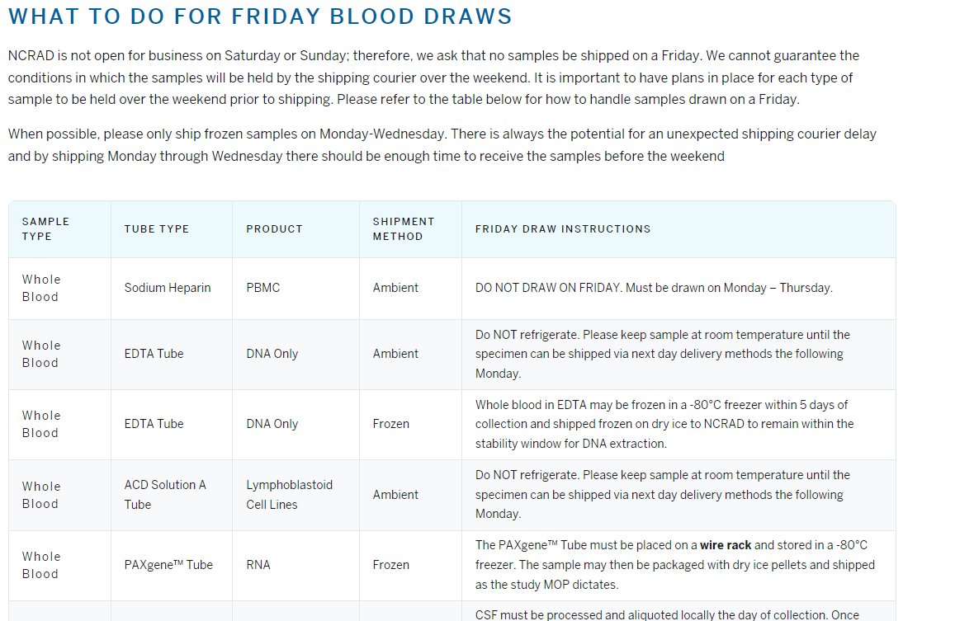
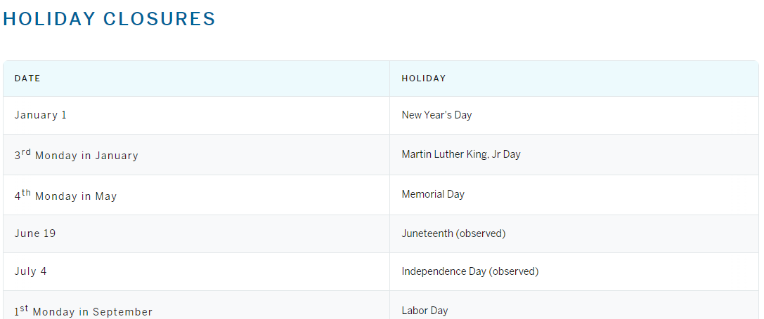
NCRAD Website
Helpful Pages
NCRAD - Friday Blood Draws
NCRAD - Holiday Closures
Notes:
UPDATE FOR SAMPLE TYPES?

Slide 52
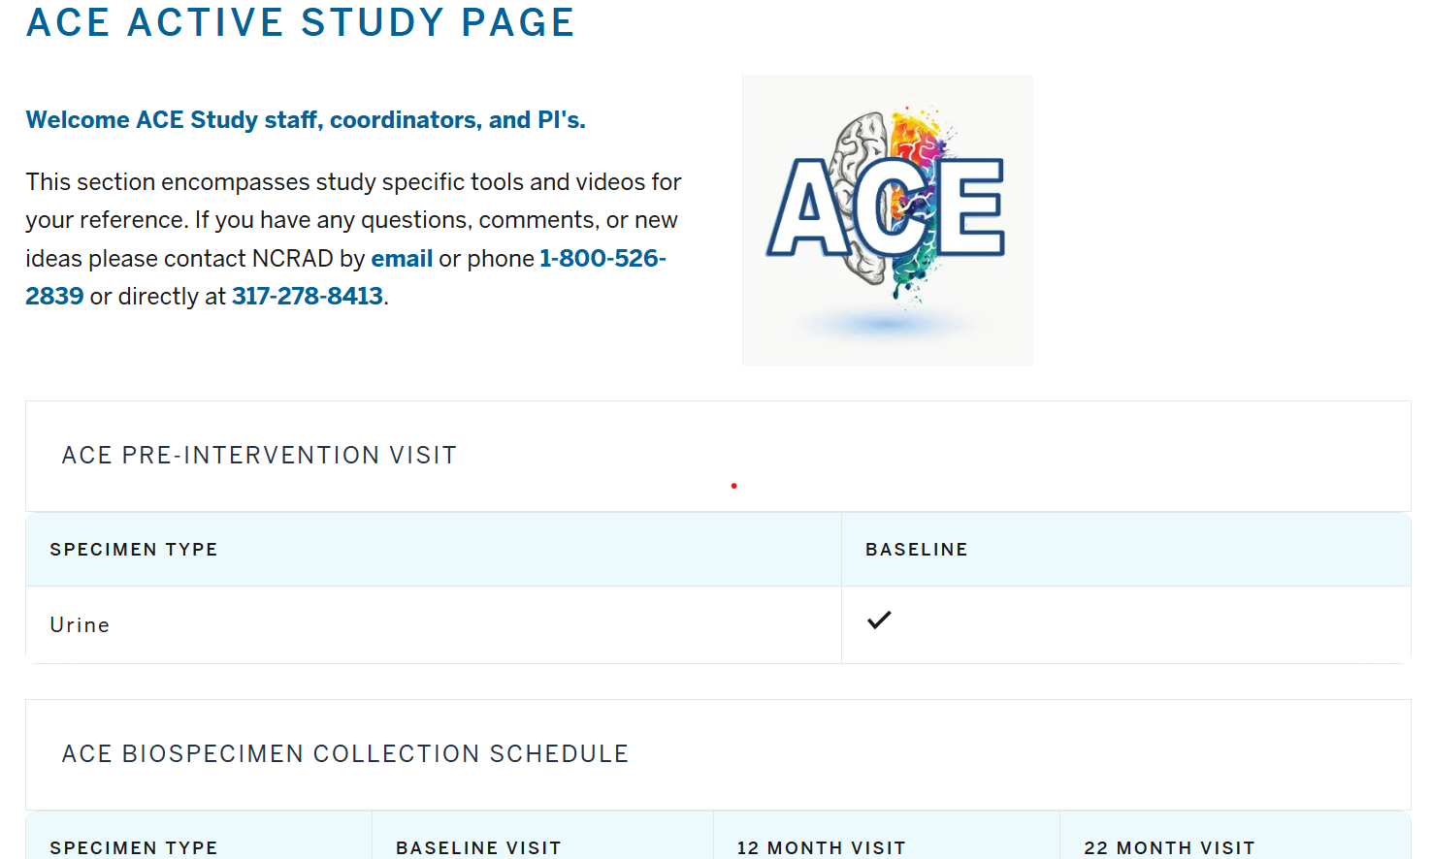
ACE Active Study Page
Notes:
UPDATE PHOTO

Slide 53
Contact Information
Questions?
Please contact NCRAD Coordinator at:
  Phone: 317-274-7890
  CRC email: dlkeys@iu.edu
  Back-up email: alzstudy@iu.edu
  Website: www.ncrad.org

